Slide 1
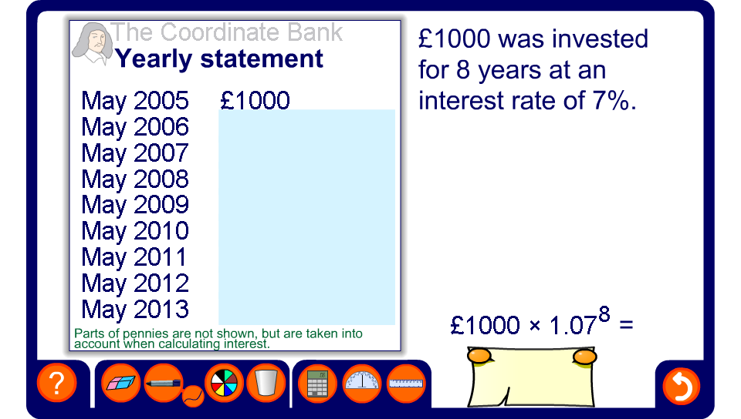


Compound interest
Notes:
Use this activity to demonstrate the effect of compound interest.

